Slide 1
1.2
Basic Components and Key Terminology of Machine Learning,
Data types
Training and testing, activation functions,
Overfitting and under fitting
Bias- variance Tradeoff.

Slide 2
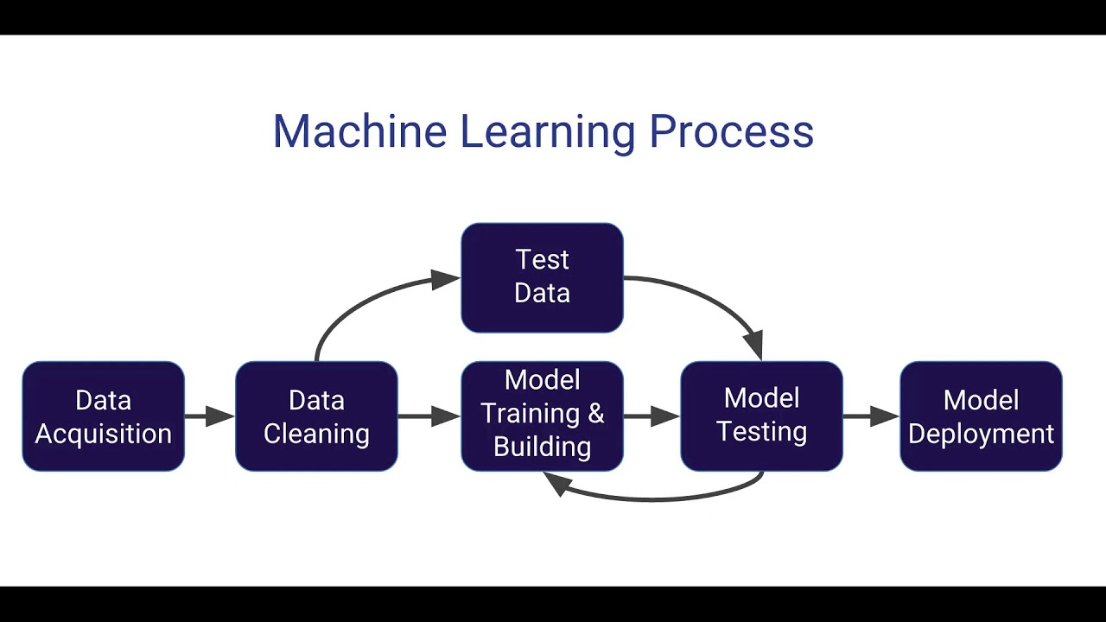
Basic Components and Key Terminology of Machine Learning

Slide 3
Key Terminology in Machine Learning
Term | Definition
Supervised Learning | Learning with labeled data (e.g., classification, regression).
Unsupervised Learning | Learning patterns from unlabeled data (e.g., clustering, dimensionality reduction).
Reinforcement Learning | Learning via rewards and penalties from interactions with an environment.
Overfitting | Model performs well on training data but poorly on unseen data.
Underfitting | Model is too simple to capture the patterns in data.
Generalization | Model's ability to perform well on new, unseen data.
Cross-Validation | A method to evaluate model performance by splitting data into multiple subsets.
Hyperparameters | Settings that define the model structure or how it's trained (e.g., learning rate, number of layers).
Epoch | One complete pass through the entire training dataset.
Bias | Error due to overly simplistic assumptions in the model.
Variance | Error due to model sensitivity to small fluctuations in the training set.
Confusion Matrix | Table used to evaluate the performance of a classification algorithm.
Accuracy, Precision, Recall, F1 Score | Metrics used to evaluate model performance.

Slide 4
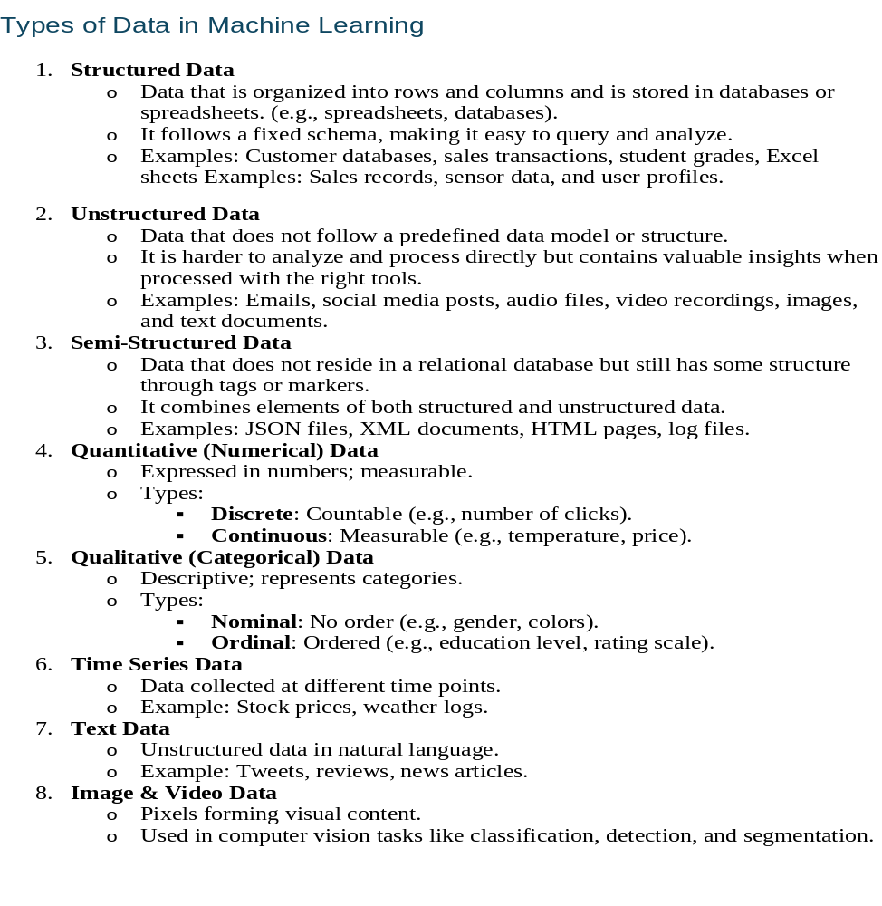
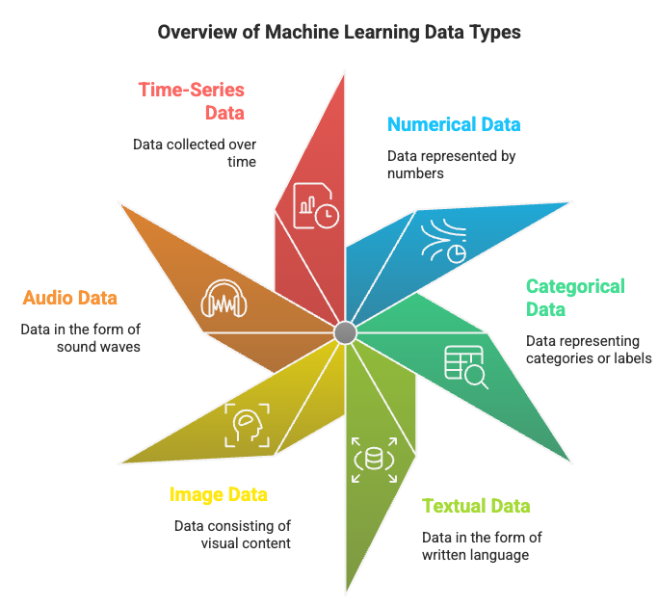
Data Types in ML

Slide 5

Type of Machine learning

Slide 6
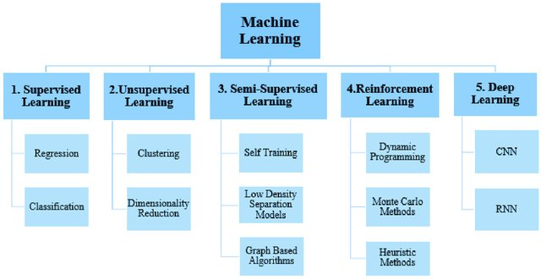

Slide 7
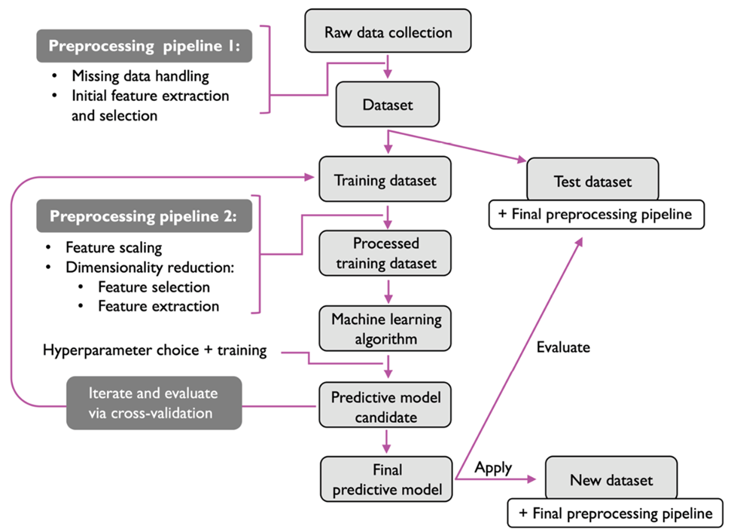

Slide 8
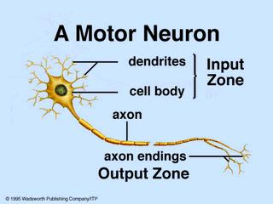
Biological Neural Networks
A biological neuron has three types of main components; dendrites, soma (or cell body) and axon.
Dendrites receives signals from other neurons.
The soma, sums the incoming signals. When sufficient input is received, the cell fires; that is it transmit a signal over its axon to other cells.

Slide 9
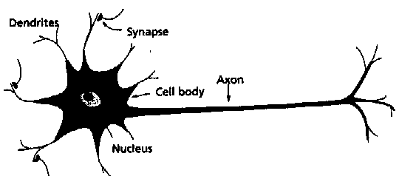
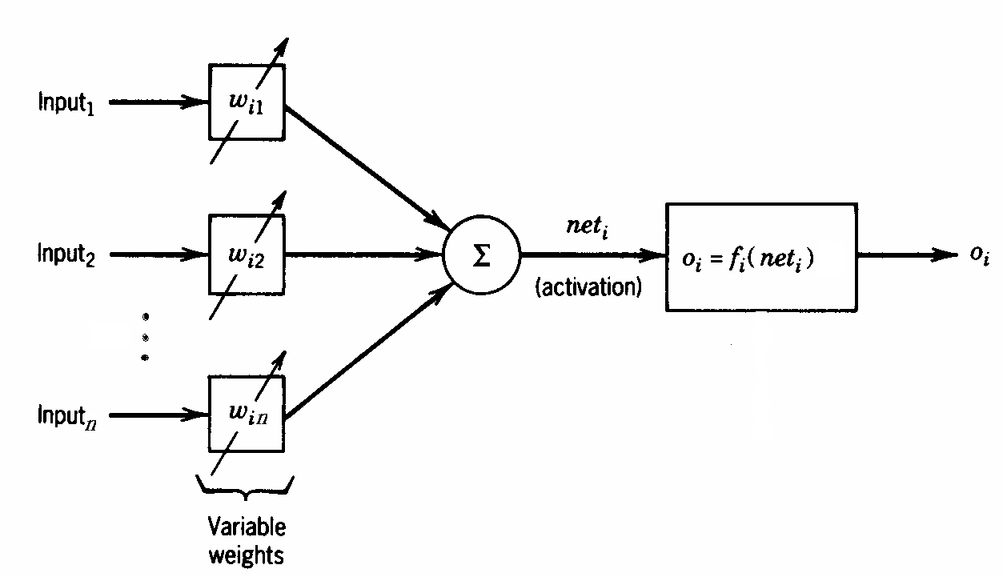
Artificial Neurons
From experience: examples / training data
Strength of connection between the neurons is stored as a weight-value for the specific connection.
Learning the solution to a problem = changing the connection weights
A physical neuron
An artificial neuron

Slide 10
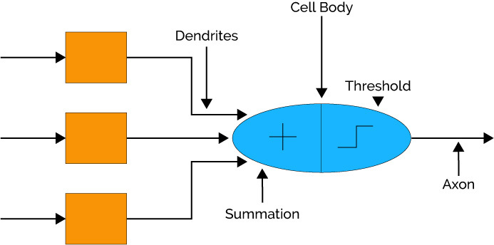
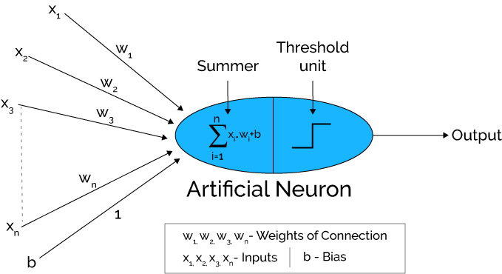
Brain Vs Computer

Slide 11
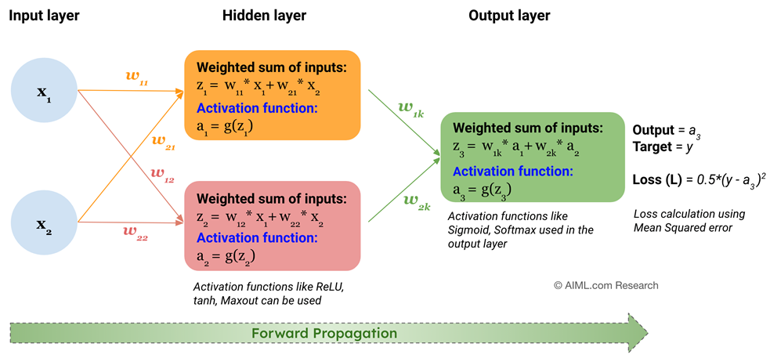
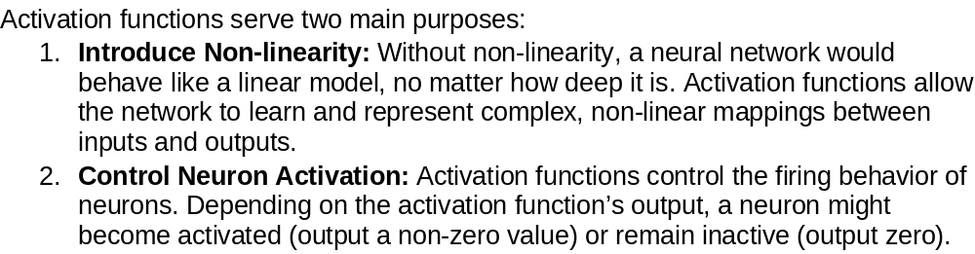
Title: Role of Activation Function in a Neural Network

Slide 12

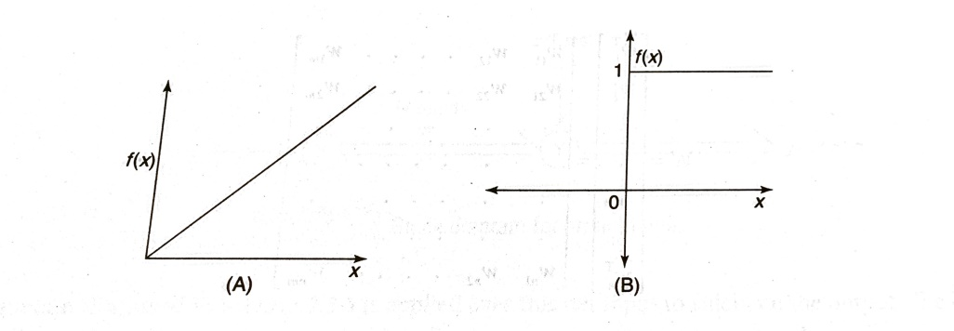
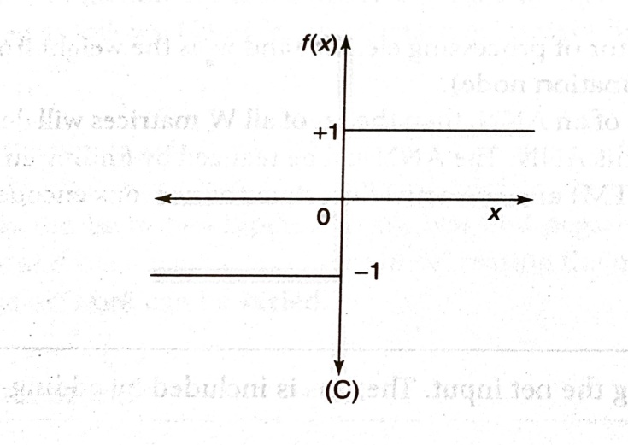
3. Activation Functions

Slide 13
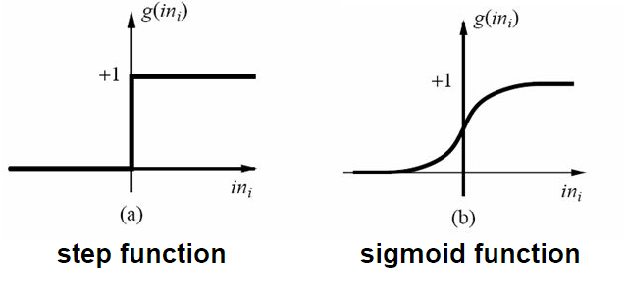
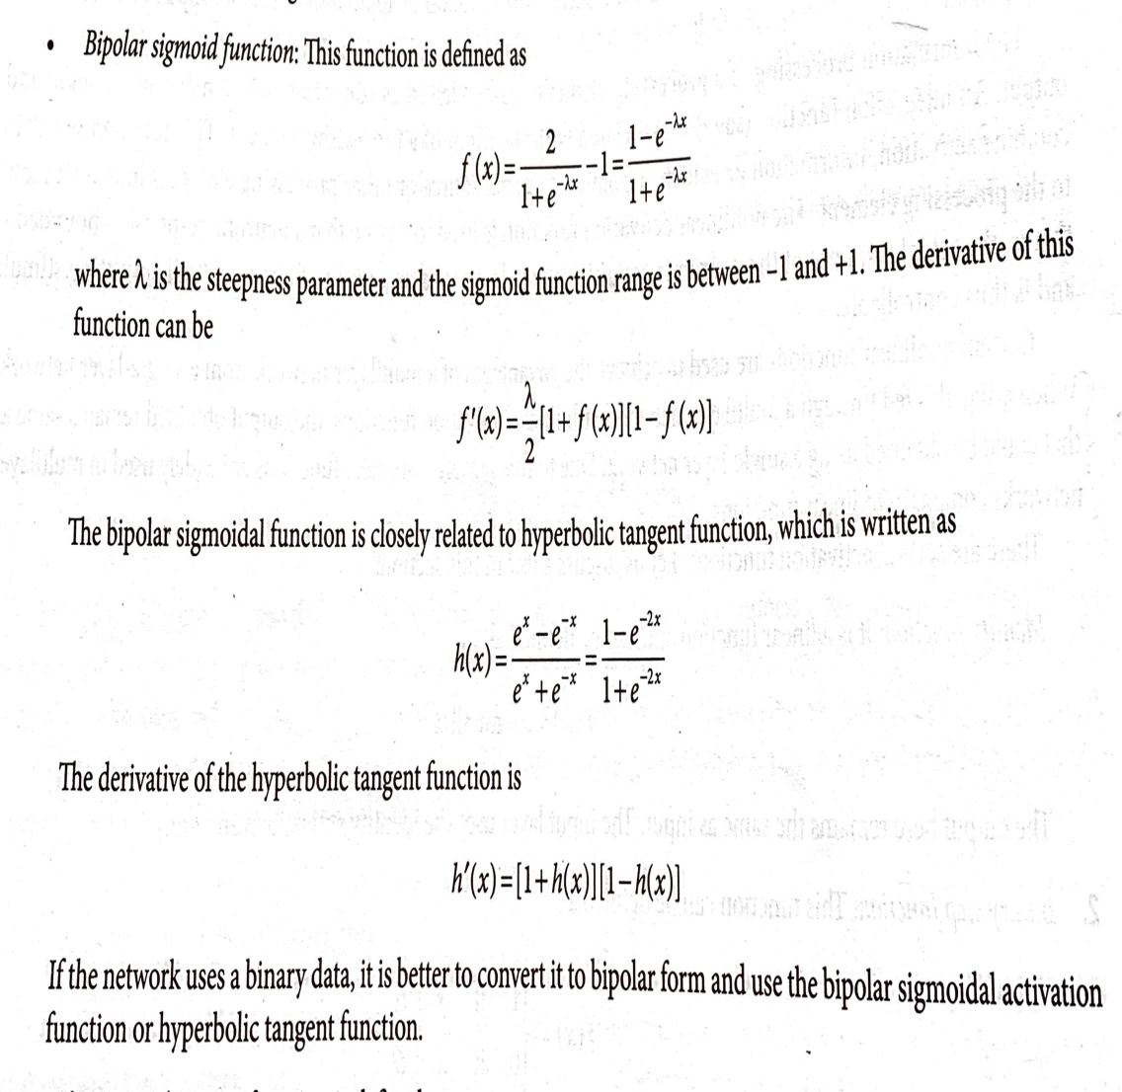
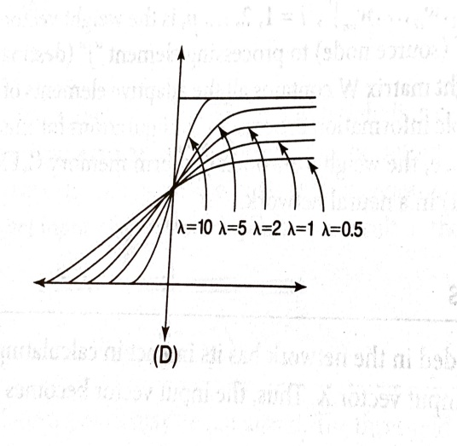
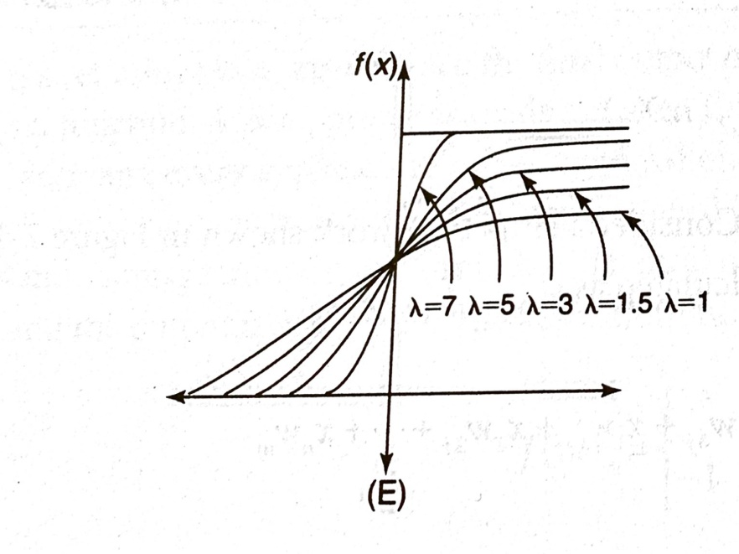
3. Activation Functions
Sigmoidal Functions

Slide 14
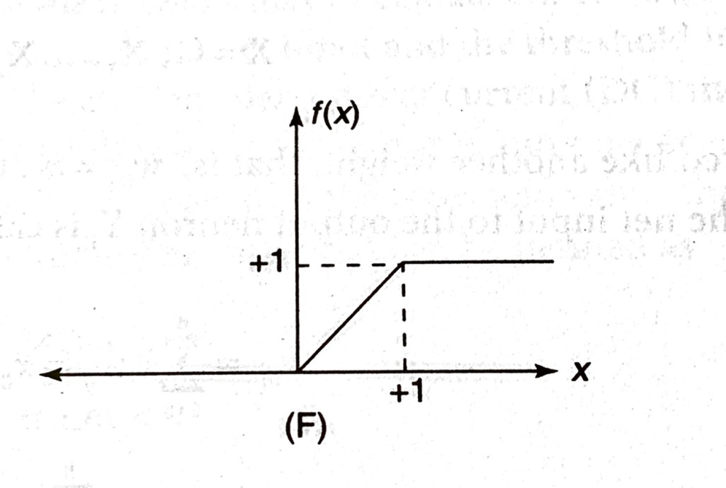

3. Activation Functions

Slide 15
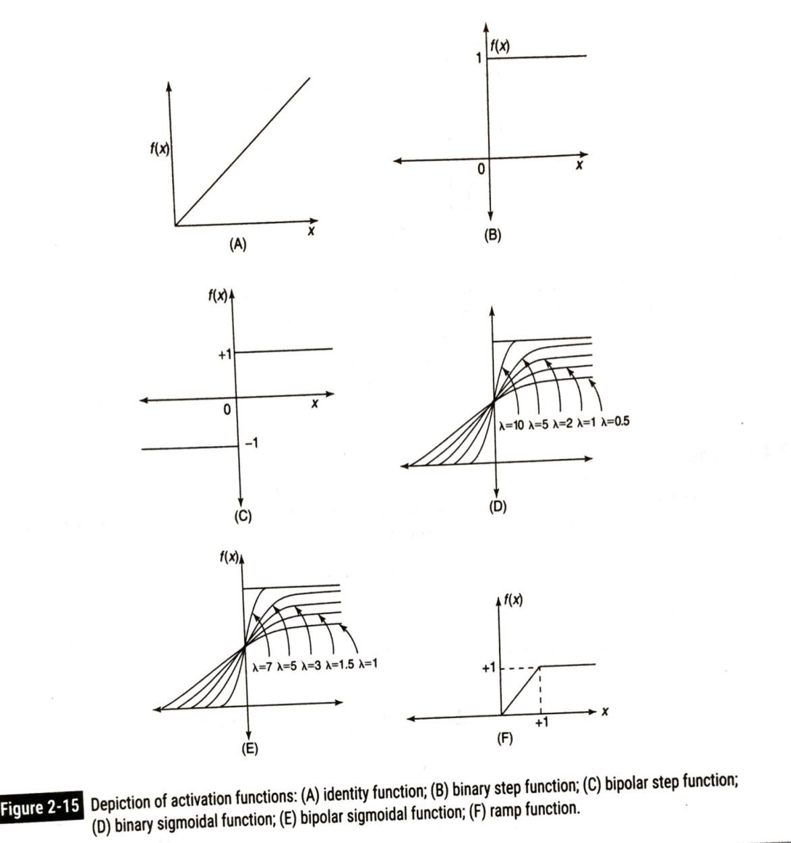
3. Activation Functions
Identity
f(x) = x
Binary step
f(x) = 1 if x >= θ
f(x) = 0 otherwise
Binary sigmoid
f(x) = 1 / (1 + e^{-σx})
Bipolar sigmoid
f(x) = -1 + 2 / (1 + e^{−σx})
Hyperbolic tangent
f(x) = (e^{x} – e^{-x}) / (e^{x} + e^{-x})

Slide 16
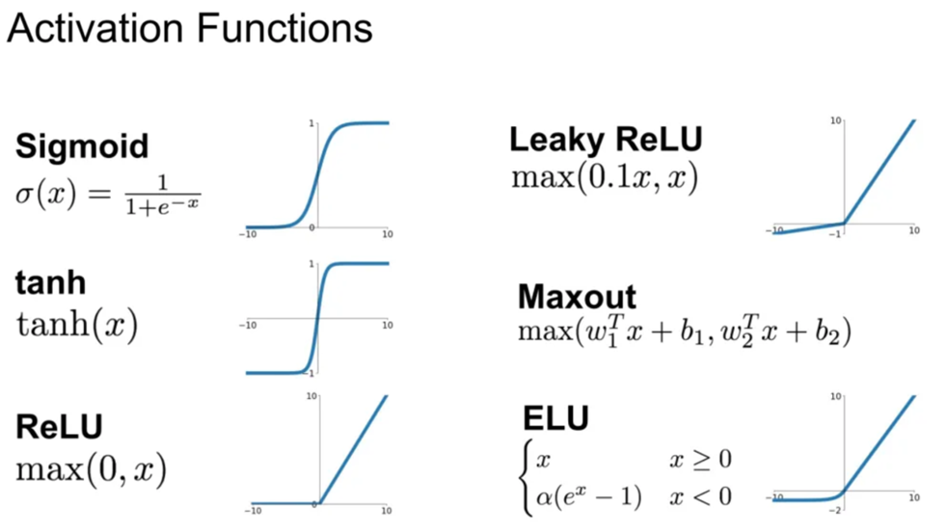

Slide 17
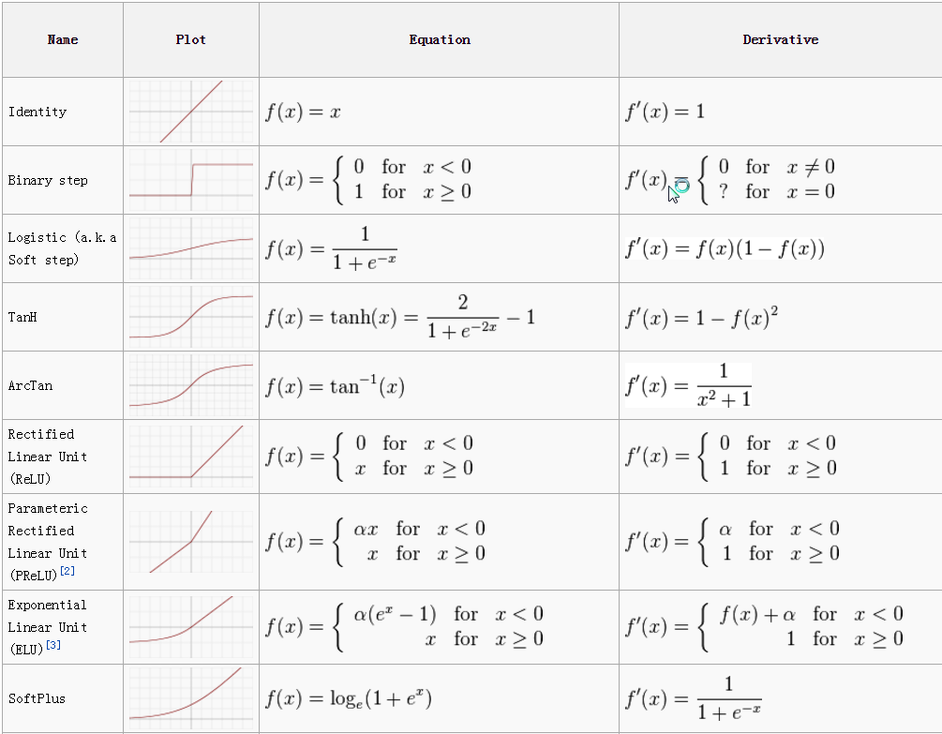

Slide 18
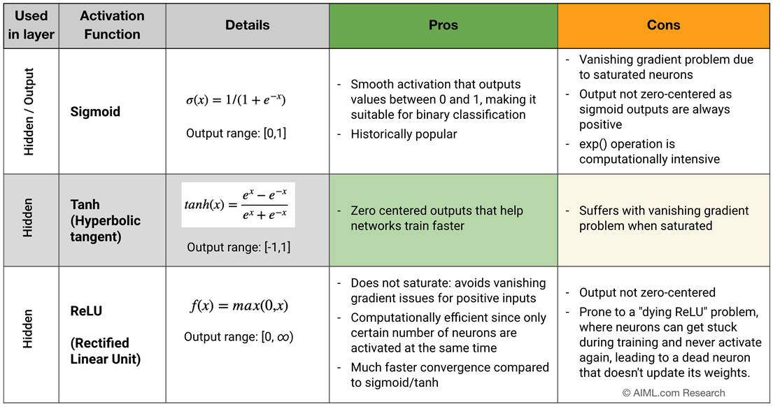

Slide 20
Which activation function to choose from?
Activation function for hidden layers:
In practice, the choice of activation functions is as follows in order of priority:
ReLU is the top choice as it is simpler, faster, much lower run time, better convergence performance and do not suffer from vanishing gradient issues
Leaky ReLU, PReLU, Maxout and ELU
tanh
Sigmoid (not preferred anymore)
Activation function for output layers:
Sigmoid for binary classification, multi-label classification
Softmax for multi-class classification
Identity / linear function for regression problems

Slide 21
Exercise
2 input AND
2 input OR
1 | 1 | 1
1 | 0 | 0
0 | 1 | 0
0 | 0 | 0
1 | 1 | 1
1 | 0 | 1
0 | 1 | 1
0 | 0 | 0

Slide 22
x₁
w₁= 0.5
∑
ƒ
y
x₂
w₂ = 0.3
Activation Function:
Binary Step Function
θ = 0.5,
ƒ(y-in) = 1 if y-in >= θ
dan ƒ(y-in) = 0
y_{in} = x₁w₁ + x₂w₂

